Slide 1
Laptop Vs. PC
A report.

Slide 2
Under supervision of:
Prof. Ibrahim Galal
A survey methodology project.

Slide 3
Members:
Name | Id
لمياء عاطف حسني عبد القادر | 20201496820
علياء حسن خلف الله حسن | 20201382331
روان عادل احمد علي | 20201472484
فيض الله محمود رياض مفتاح | 20221445636
احمد السيد ابراهيم احمد | 20221454559
محمد يسري محمود محمد | 20221461358
حازم مصطفي احمد عبد المجيد | 20221442259
احمد سعيد علي زكي خميس | 20221442252
سهيل عادل عبد الغفور عبد الغني | 20221375835
محمد حمدي حسين علي | 20221461046
Name | Id
هاجر محمد ابراهيم إبراهيم | 20221379334
أحمد صلاح عبدالرحمن محمد | 20221442249
دينا عبدالله عبدالصادق | 20201475307
يوسف محمد صلاح راشد | 20221454639
جهاد احمد نصر معروف | 20201475860
سلمى ياسر محمد سليمان | 20221030678
معاذ ممدوح فوزي احمد | 20221454751
خالد عبدالحميد حمدي محمد | 20221041599
جهاد محمد محسن إبراهيم | 20221370605
عمر علاء الدين | 20221447767

Slide 4

The Proposal
Phase I

Slide 5
I. The Proposal
A zoom meeting took place to discuss the main objectives and the factors that come into play when choosing a laptop or a PC such as:
  Demographic
  Computer knowledge
  Performance, upgradability, screen size, build or model
  Career plans
  How time is spent on these devices
  Market Distribution

Slide 6
I. Cont..
The selected population for the survey are students from FCDS, levels 2 and 3 .
Survey design will contain open ended and probing questions next to close ended questions, to gain insight on more factors that could affect the laptop vs PC choice.
Google forms will be the main tool for the questionnaire.
Defined a timeline, a month where each week has at least 1 phase finished.
Confidentiality and privacy of participants are to be maintained.
At the end we will be able to provide valuable insights into how people prefer and use PCs and laptops. And using market research data that we gathered, we can potentially increase the profit of a company that specializes in this field.

Slide 7
The Questionnaire
& Pre-test
Phase II & III

Slide 8
II. The Questionnaire
We followed a traditional questionnaire sequence, although starting with the demographic questions.
We used Google forms for both pre-test and the actual questionnaire.
Open ended questions were used to get more insights and subjective opinions. Example: ”From your point of view , what do you prefer more laptop or pc , state your reasons”.
There are many attributes to be taken into consideration so we used scale questions (1-5).
The set of questions used as a whole, are complementary to each other thus achieving the objectives that we set in the proposal.

Slide 9
III. Pre-test
We conducted 2 stages of pre-testing for the sake of having two different datasets that would describe how well we did with changing our questionnaire.
Stage 1 was conducted on 13 interviewees, 5 of which were not recorded.
Stage 2 was conducted on 5 interviewees and all of them were recorded.
After reviewing the data sample that we took from the interviews, there were some modifications to be done to the questionnaire:
  One qualifying question was added.
  Spelling errors were corrected.
  A lot of paraphrasing changes to increase clarity in both questions and answers.

Slide 10
III. Cont..
    Changelog examples:
      Specs question was open-ended → close-ended, as most people will not fill it if it’s open-ended.
      “If you had the chance to buy a device again, what would you prefer?” is not clear. → “If you got the chance to rebuy the main computer device (laptop , pc ) you use at moment what would you choose instead”.
      “how important is this attributes to you” question: fixed scale range(0:4)→(1:5).
      “Income level” question → increased range of answers (lower/higher medium).
      “If you own both laptop and desktop computer ,which of them do you use more ?” answer changes (mostly , sometimes , more than ,less than) → % using laptop and % using pc.

Slide 11
Data Collection
Phase Iv

Slide 12
IV. Data Collection
After collecting answers for 1 week a dataset was ready to be cleaned out and filtered properly.
The dataset was cleaned both manually and with python code for more efficiency.
During the cleaning process a few changes were made:
  Converted text value to numerical values to make it easier to use analysis techniques that depend on numerical values. Example: Income level Low=1 , Medium=2 , Lower medium=3 , Higher medium=4 , High=5.
  Any misvalues were replaced by NULL value.
  In the “Main usage of your device” , in cases of multiple choices we took the first choice as we want to know the main usage. This was done to help out in the analysis phase as this is one of the important parts of the survey.

Slide 13
IV. Cont..(1/2)
  For a more thorough filtration of the population, if “ID” doesn’t start with 2020, 2021,2022 or not understand , value is changed to NULL.
  Due to popularity of intel processors, a column was created “Is it intel” to check if the processor was intel (1 for intel, 0 for AMD/Ryzen/Snapdragon). This was made to group them by generation, as intel generations range from 1 to 13 and for example AMD generations range from 1 to 7.
  In the column “Device price” we took the small values that are more probable to be respondent mistakes and fixed them (Ex: 15 to 15000 or 8 to 8000), and the completely illogical values and set them to NULL (Ex: 1 or 0).
  We created 3 columns to take the values from “Which of these devices do you own”, one for each device (PC/Laptop/Tablet). The chosen devices has their value set to Yes and the rest is automatically set to No.
  To ensure validity, in “If you own both laptop and desktop computer ,which of them do you use more”, anyone who chose that they prefer to use one device over the other and at the same time they did not choose 2 devices in “Which of these devices do you own”, we considered this as an oversight and changed the value to correspond to the device they chose. (Ex: someone owns a laptop only and chose “80% using laptop 20% using desktop computer” value is changed to “I only use a laptop”)

Slide 14
IV. Cont.. (2/2)
  Using answers from both “If you got the chance to rebuy your device” and “Which devices you own”, we made “Would they change their device” and if they chose to keep the same device the value is 0, else 1.
  Also based on devices chosen and the preference % of choice, a “main device” column was created.
  “Main usage” was created based on the highest number of hours in the hours section.
  Two columns were created that indicate how powerful the chosen processor and graphic card are.
  To reduce redundancy and help with clustering, only the first 3 or 4 words were taken from the cells in “The best choice to describe your device performance” which are sufficient to describe the performance.

Slide 15
Expectation vs Real
Phase v

Slide 16
V. Expectation vs Real
The survey was sent out to a group of 400 students.
A total of 108 surveys were answered.
292 were unanswered.
There were 2 answers that we considered as careless-ness answers.
Final number of answers taken into consideration was 106

Slide 17
Data Analysis
Phase VI

Slide 18
VI. Data Analysis
This phase was done over 4 parts:
  Data Preparation & Additional Cleaning
  Descriptive Analysis
  Inferential Statistics
  Model Building and Interpretation

Slide 19
Part 1: Data preparation & Additional Cleaning
Dropped carelessness responses and analytically useless columns.
Filled up Null values in numerical columns with the average of their respective values. Ex: null values in the price column → the average price of all
devices
Limited scalability in some columns for easier analysis. Ex: Anyone having +5 devices will be considered as only having 5.
Created 2 columns that measure the percentage or the ratio of laptop/pc usage
Created 2 columns for visualization’s sake, the 2 columns being a ratio for which device you want to rebuy/replace.

Slide 20
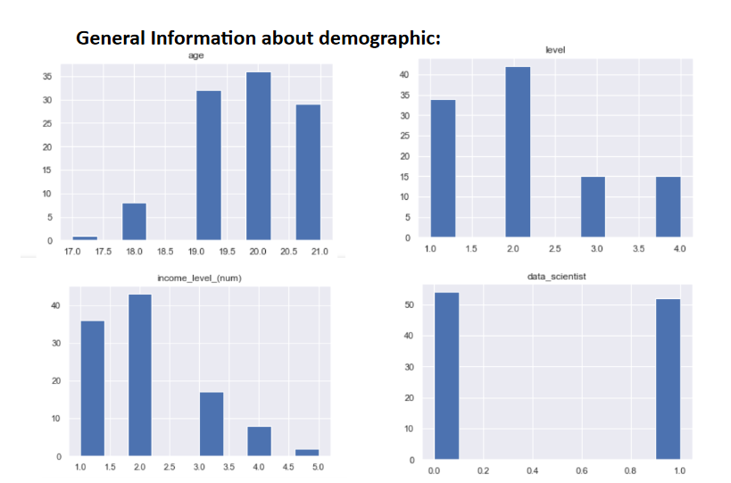
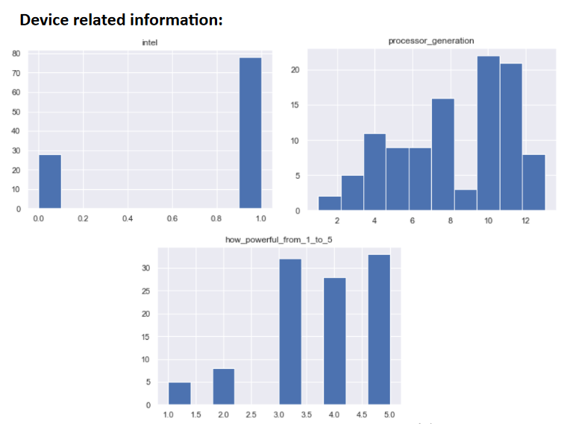
Part 2: Descriptive Analysis
We were able to obtain some insights and knowledge about the data we have through visualizing the data that we have. First we made histograms of all important columns that we have. Examples:

Slide 21
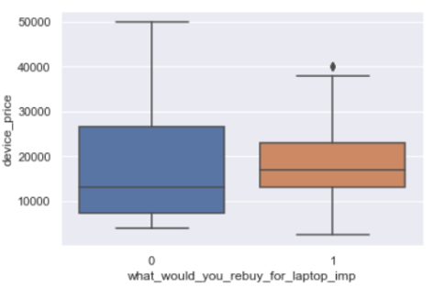
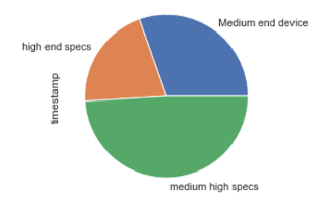
Cont..
Information we found useful:
  Correlation coefficient between people who would rebuy a laptop and
  hours spent gaming was -0.4129, which means the more hours people
  spend on gaming, the more they are likely to get a PC instead.
  We found a very high correlation value between the portability of the
  device and the need to work without a cable, the value was 0.7188 .
  When we checked the consistency of device prices in relation with their specs by looking at the average, we found that device price is consistent with device performance.
  The target audience for the survey seemed to prefer medium high specs in their devices.
  The people who would prefer keeping or rebuying laptops have a higher
  average income than those who would prefer to buy PCs.

Slide 22
Part 3: Inferential Statistics
We wanted to find if people spent more money on laptops or PCs. Due to small sample size and distributions being hard to identify, we used Bootstrap Algorithm instead of alternative hypothesis test.
By calculating bootstrap mean =110.2826, and 95% confidence interval [-5252.1739 , 5250.0]
The bootstrap hypothesis test is performed by checking whether the value for the variable lies within the acceptance region or not, since the null hypothesis states that 𝑋=0 where 𝑋= 𝜇1−𝜇2, and 0 lies inside the acceptance region, therefore we do not have enough evidence to reject the null hypothesis, that people tend to spend more on one device than another.

Slide 23
Cont..
We did another 3 tests using Chi-Square Test (95% conf) :
Find out if the gender and purchase choice, are dependent. → Result: p-value = 0.12639 >𝛼, we cannot reliably reject the null hypothesis. Not enough evidence to say that gender and purchase decision are dependent.
Find out if age and purchase decision, are dependent. → Result: p-value = 0.44635>𝛼, we cannot reliably reject the null hypothesis. Not enough evidence to say that age and purchase decision are dependent.
Using the same test on the factors matrix to find out about the dependency
  With alpha = 0.05, the only two factors that show dependency is how much a user cares about portability and working without cable, which are highly correlated because the latter is part of the first.
  Using alpha = 0.1, we can be at least 90% confident that the screen size also shows dependency.
  For other tests, there is not enough evidence for dependency.
  Other factors will be checked through logistic regression analysis

Slide 24
Part 4: Model Building & Interpretation
Dropped columns with multicollinearity. Ex: 'affordability_importance', 'working_without_cable_importance’.
Main statistical algorithm used is Logistic Regression, to obtain odds
ratio in the presence of more than one explanatory variable based on
prior observation of a dataset.
Used One-hot encoding from the sklearn library, which can be used to
transform one or more categorical features into numerical dummy
features, useful for training model.
Split data for training and testing.
Upon testing model we found its accuracy to be better than baseline, and that it was ready for us to use the whole data.

Slide 25
Part 5:a Reliability
Started with some preprocessing removing some columns, changing some
column to be numerical
Then we used Cronbach alphaa from pingouin lib to get general Reliability
Then we normalized the “device price” dividing it by it’s max value And redid Cronbach

Slide 26
Part 5:b validity
For the validity stage we resent the survey for some of the respondents asking them to refill it if possible , getting a 10% of the original respondents to refill it half of which didn’t write their id’s properly the first time , making the validity data 5%
For those 5% data , we calculated how identical there answer was to theirs first response ,result was (90%, 81%, 87%, 0.87%, 48%).
So we have an average validity value of 79%

Slide 27
Observations-Key findings
The 'portability importance' is the most effective feature for increasing the odds of buying a laptop as the next device. An increase of the 'portability importance' feature by one unit increases the odds of buying a laptop by a factor of 2.6 when all other features remain the same.
An increase of the 'laptop usage percentage' feature by one unit increases the odds of buying a laptop by a factor of 2.25 when all other features remain the same.
An increase of the 'income level' feature by one unit increases the odds of buying a laptop by a factor of 1.89 when all other features remain the same.
An increase of the 'CD existence importance' feature by one unit increases the odds of buying a laptop by a factor of 1.75 when all other features remain the same.
An increase of the 'How powerful is your processor' feature by 1 unit increases the odds of buying a laptop by a factor of 1.74 when all other features remain the same.

Slide 28
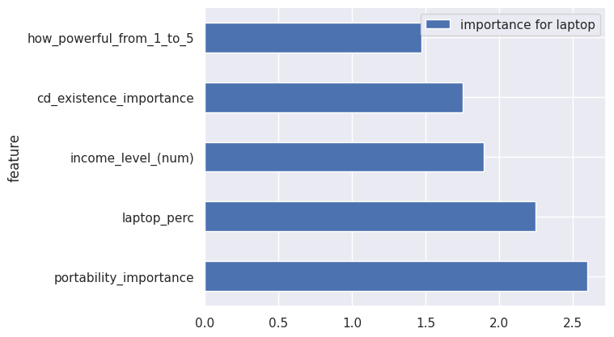
Observations-Key findings

Slide 29
Observations-Key findings
An increase of the 'performance importance' feature by one unit increases the odds of buying a desktop as the next by a factor of 2 when all other features remain the same.
An increase of the 'screen size importance' feature by one unit increases the odds of buying a desktop by a factor of 1.6 when all other features remain the same.
An increase of the gaming time by one hour increases the odds of buying a desktop by a factor of 1.5 when all other features remain the same.
An increase of age by one year increases the odds of buying a desktop by a factor of 1.4 when all other features remain the same.

Slide 30
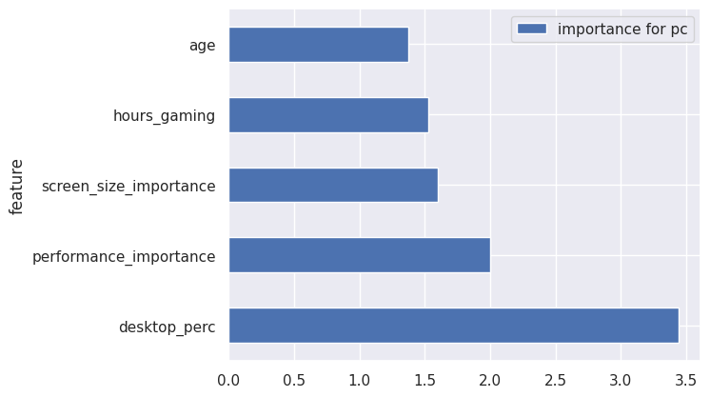
Observations-Key findings

Slide 31
Thank you!

